Slide 1
Parking Management system
(CS 5220) Adv Application Programming in Java
Project By
Gaeya Neha Thimmareddy (700699186)
Prathima chowdhary nunna (700703064)

Slide 2
Introduction
Parking Management System web Application mainly deals with the parking slots in the buildings like clubs, hotels, malls and many more.
In this Web application we can access the information of parking slots in the building where is free. By finding the empty space the user can block the slot prior date.
This application also provides information about the user like Car Number, License Number and email ID for the administration so that they will be able to notify the user about confirmation and other details.

Slide 3
Existing and proposed system
Existing System:
We already have many car parking management systems which can provide services for the users only with the help of RFID tags or sensors.
In the Existing System, by using the electrical equipment only we can find the empty slot by an indication method.
We can only identify the free slot but we can’t book the slot before.

Slide 4
Proposed System:
The purpose of this project is to ease the process of parking through the web application.
In this we mainly concentrate on parking slot in the building and the user is able to block the slot before entering into the building prior date and time.
The web application is designed for client side.
It contains only user friendly options.
The main feature of this Parking Management system is it helps you to enter the employee coupon for the free parking if the company you are working with is associated with our application.

Slide 5
Functional requirements
Admin:
Admin can login into the website by using his/her username or email address and password. If the entered details are correct, the admin can log into the system.
Admin Registration: Admin needs to create an account using License
Admin Login: Admin needs to login to account which was created.
Add Bookings: Admin can add booking slots based on the availability.
Bookings: Admin could be able to book the slot for the customer if he paid for the slot.
Slot: Admin can add the slots for parking by the Area, Parking complex, number of slots and price.

Slide 6
Update Prices: Admin can change the prices of the parking slot based on time and demand.
Update Slot: Admin would be able to add new Slots available.
View all Confirmed payments: Admin can view all confirmed payment for slots.
Listing all the slots: Admin could be able to list all the existing slots.
Approve: Admin can be able to approve slots based on payment and availability.
Reject slots: Admin can be able to reject slots if they are full.
Approve Coupon: Admin will approve the coupon for free parking if the customer is the employee of the company associated with our application.
Email Confirmation: Admin will send the booking confirmation through email to the customer.

Slide 7
Customer:
Registration / Sign-up: Customer needs to create on account to book and view parking slots available in application. To create an account customer required to enter the details such as Email address, car number, License, mobile number, password.
Login: If Customer has already created an account, he/she can login into the system by using Username or email address and password. If the entered details are correct, then customer can log into the system.
Forgot Password: If Customer forget the password with which he already registered; he can use the forget password option.
Create New Password: Once he/she click on forget password he would be directed to new screen with create new password option.
Search for Slots: Customer can search for the available slots and add them to the bookings page.
View Booking Information: Once Customer select the slot then he/she can view the details of the booking like price and duration time.
Bookings page: Once the slots are finalized customer need to make booking by making the payment.
Making a payment: Based upon the time the cost of the parking slots is available to the customer.

Slide 8
Required date: Customer would be able to select parking slot on the required date.
Payment Details: Customer would be able to select the payment mode paypal/credit/debit modes.
Payment Confirmation: Once the customer selects the date and slot booking gets confirmed accordingly.
Edit bookings: Customer would be able to edit the booking to any other day/time if available.
Cancel order: Customer would be able to cancel the booking if placed at least before 1-2 hours.
Apply coupon: Customer can apply the Coupon for free parking.
Email confirmation: Customer can get the slot booking confirmation to the email.

Slide 9
Non functional requirements
Response-Time: For all APIs in the application the response time is 3 – 4 secs.
Reliability: This application is designed to help the users consistently show the correct details.
Usability: This program is very simple to use and is designed with all users from various backgrounds in mind.
Security: Login and Logout options are provided for user to securely access the application.
Availability: The system can operate for approximately 24/7 in terms of availability.

Slide 10
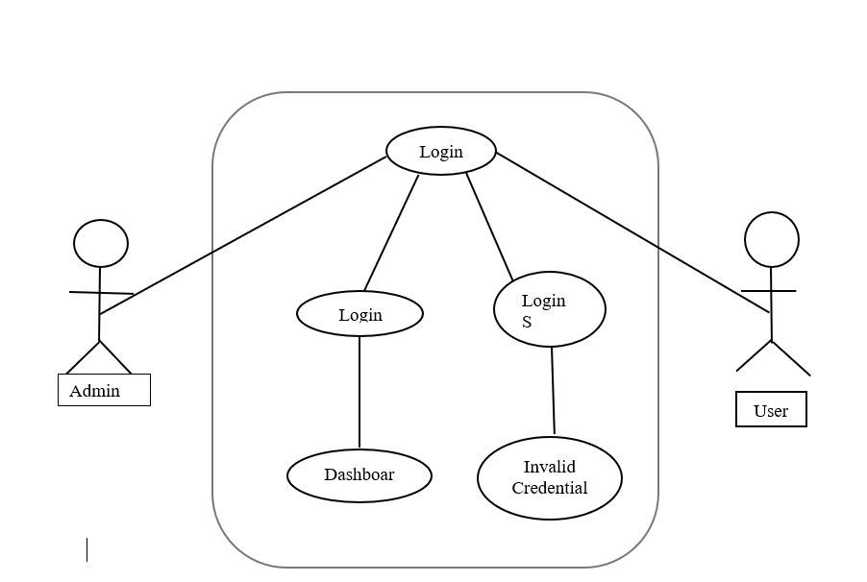
Admin customer Use Case Diagram

Slide 11
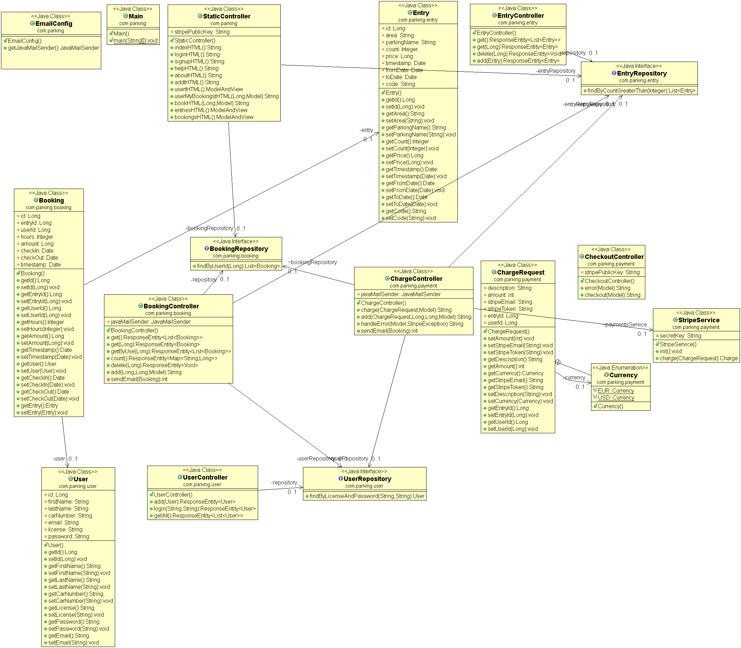
Complete Class diagram of the application

Slide 12
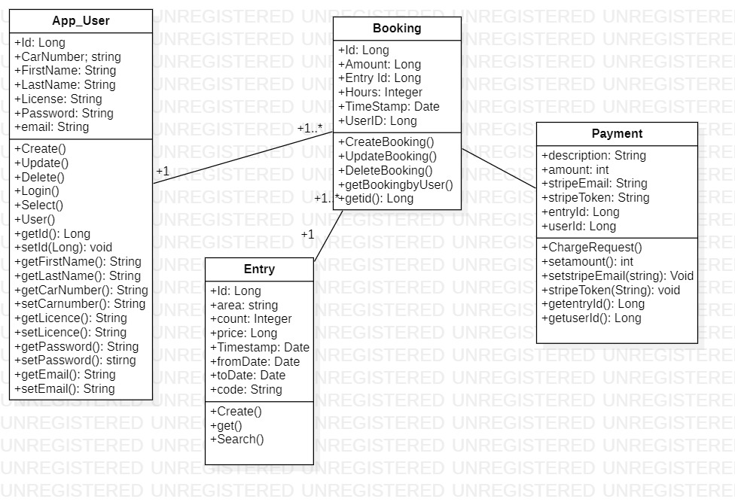

Slide 13
Algorithms and data structures
Algorithms:
In this project we have not used any Algorithms as all the information needed were directly retrieved from database.
Data Structures:
In this project we are using ArrayLists to show the list of available parking slots for a user because of the following reasons:
We can dynamically increase the size of list using Array List
Elements with-in Array List can be any type of object.
It helps us to view the list at random and it maintains the order of insertion.

Slide 14
Java frameworks used for the project
JavaFX:
JavaFX is used to create the view of an application like :
Registration pages
Login Pages
Displaying Parking and Booking Information
Spring Boot:
Spring MVC with thymeleaf UI is used with Bootstrap Styling. Thymeleaf is a Java template engine for processing and creating HTML, XML, JavaScript, CSS, and text. In this article, we will discuss how to use Thymeleaf with Spring along with some basic use cases in the view layer of a Spring MVC application.

Slide 15

Demonstration

Slide 16
Thank you

